Slide 1




Design Management
: Creativity and the Organisation
■
Dr David Hands
Design Management
Lecture No.9
■
■
14 February 2018
■

Slide 2
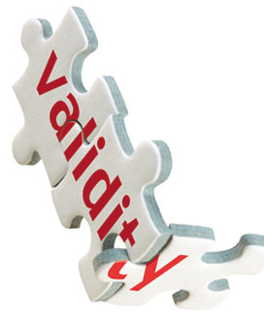
Implementation:
managing design
This is the stage where design projects are delivered. The focus of this stage is placed on the process and practice of managing projects.

Slide 3

Implementation:
managing design
The materials specified and the production processes used in the design and delivery of products and services is increasingly under scrutiny by both share and stakeholders, consumers and clients.

Slide 4

Implementation:
managing design
Design can, and does, play a role in contributing to environmental and social problems but taking a responsible approach to design brings the opportunity to shape a more environmentally and socially aware future.

Slide 5
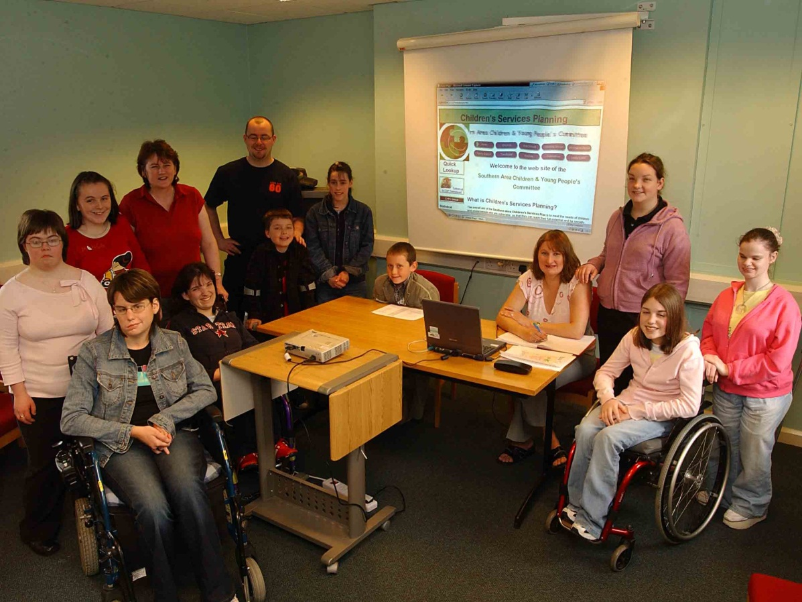
Implementation:
managing design
Responsibility to clients; customers and users with distinct user-needs.
Adds valuable competitive advantage amongst increasingly demanding and emotionally involved audiences.

Slide 6

Implementation:
managing design
Companies that do not take a long term view are missing important and rapidly shifting trends.

Slide 7
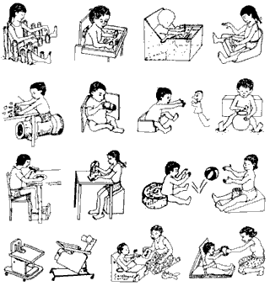
Implementation:
managing design
Design managers play an important role in improving the flow of information on new sustainable materials and techniques.
For Example……………………………………

Slide 8

Implementation:
managing design
Consumer trends indicate that people are willing to pay more for ‘ethical’ (healthier, safer, environmentally friendly or socially responsible) products or services.

Slide 9

Implementation:
managing design
Increasingly, consumers want to know more about a product; how it was made; where it was made; even who made it under what conditions…..
Sourcing raw materials

Slide 10

Implementation:
managing design
Would you tolerate this?

Slide 11
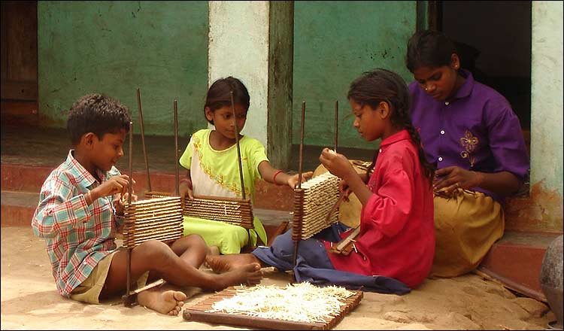
Implementation:
managing design
Or this…………………………….?

Slide 12
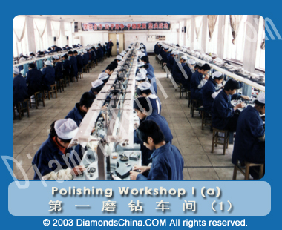
Implementation:
managing design
Production Processes
Design can make manufacturing and production processes more efficient, whether through refining existing workloads or setting up a whole new system from scratch in order to reduce massive environmental burdens.

Slide 13

Implementation:
managing design
Environmental Cost
Design has a direct impact on the energy and resource consumption of the products and services we buy and use.

Slide 14
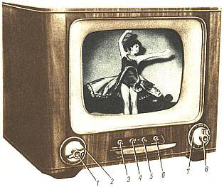
Implementation:
managing design
For example – the energy wasted by leaving televisions and videos on standby can be reduced through new environmentally friendly approaches to the design of technology.

Slide 15
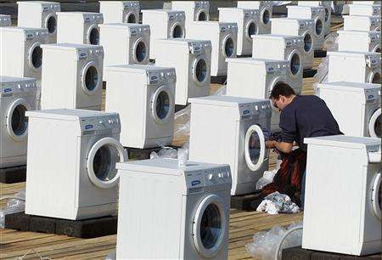
Implementation:
managing design
Zero Waste society
Packaging is also a major contributor to unnecessary cost and waste.
Redesigning packaging is a challenge that can be addressed through the design of refillable bottles, or totally recyclable packaging.
End disposal

Slide 16

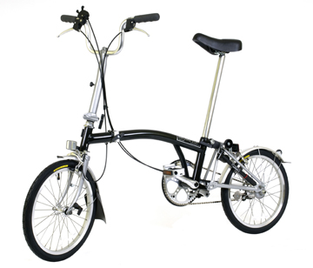

Implementation:
managing design
Design Policies, Procedures and Guidelines

Slide 17

Implementation:
managing design
Design Policies
Documenting an organisations attitude to design helps everyone engaged in the business understand [and value] how design operates at the various levels of business operation.
This documentation often takes the form of a ‘Design Policy’

Slide 18

Implementation:
managing design
Design Policies
The design policy is a useful tool or means to embeds design into the way a company thinks and acts…

Slide 19

Implementation:
managing design
Mark Oakley argues “…Too many companies make the big mistake of rushing into design projects without first considering the implications of what they are doing…”

Slide 20

Implementation:
managing design
Design Policies explain the thinking behind why something has to be done a particular way and gives broad outlines for making [strategic] design decisions.
Prof. Rachel Cooper argues that a design policy “…defines the meaning of design within the organisation, and serves to reinforce the brand and vision”

Slide 21
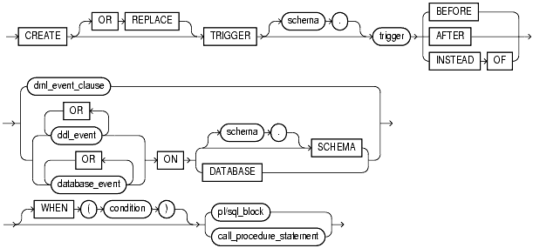
Implementation:
managing design
An organisation’s design policy will set the framework for the procedures to be followed when using design.

Slide 22


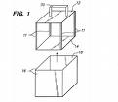
Implementation:
managing design
Design procedures detail what needs to be done internally to successfully procure and engage design services or initiate a project.

Slide 23

Implementation:
managing design
In essence, design procedures improve the ability of the organisation to contract design resources effectively and efficiently.
Design Managers should help set-up these procedures as they will ultimately define the criteria under which services will be procured, evaluated and how design will be measured by the company.
Money spent vs. Value added….

Slide 24

Implementation:
managing design
To ensure consistency across all applications, brand guidelines not only provide practical information about how to create a brand but also maintain it…

Slide 25

Implementation:
managing design
Design guidelines outline how to translate an organisations brand vision into its products, services and spaces…

Slide 26
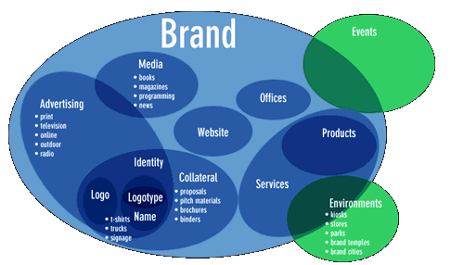
Implementation:
managing design
Experience of the brand

Slide 27

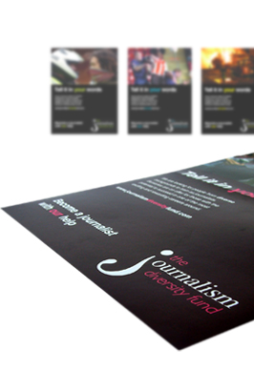
Implementation:
managing design

Slide 28
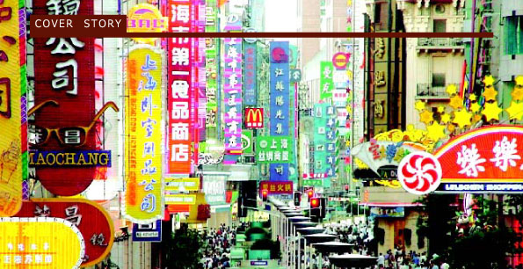
Implementation:
managing design
Strong identity in crowded marketplaces

Slide 29

Implementation:
managing design
Design guidelines can include:
use of logo
colour
typeface
layout of physical space
visual merchandising

Slide 30
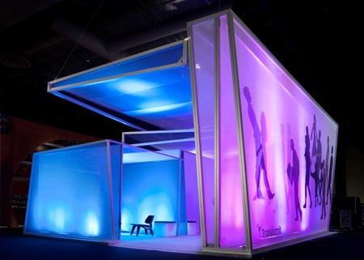
Implementation:
managing design
Guidelines will also outline the organisations approach and attitude to design in relation to corporate objectives.

Slide 31

Implementation:
managing design
Guidelines useful when working with external design consultancies;
Plus – useful starting point when rolling out a regional or global design solution.

Slide 32
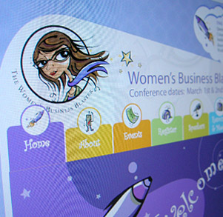

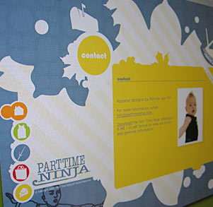
Implementation:
managing design
Maintaining & Monitoring The Design

Slide 33
Implementation:
managing design
Design investments need to be looked after, just like any other asset in the organisation
Often on completion, projects maybe handed over to clients with accompanying manuals, instruction books or tools. These provide advice on looking after the ‘design asset’.

Slide 34
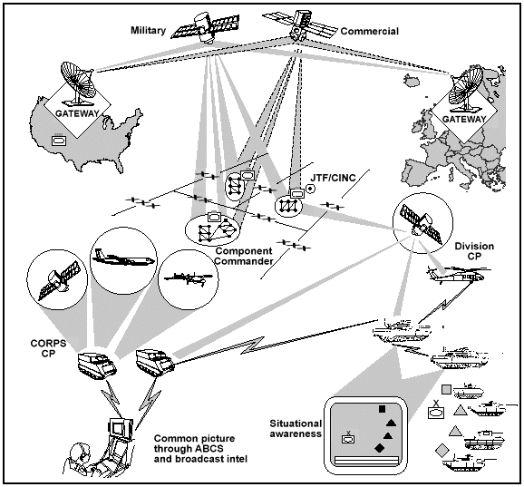
Implementation:
managing design
Translating ‘Global’ Design into ‘Local’ Design

Slide 35
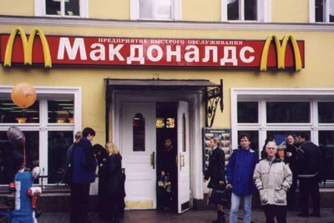
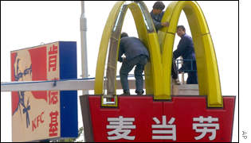
Implementation:
managing design
Companies wanting to expand their customer base often have to transcend geographic borders to increase their revenue and market share.

Slide 36



Implementation:
managing design
Customising design to suit specific countries

Slide 37

Implementation:
managing design
Design Managers play a crucial role in translate global brands into locally and culturally relevant products and services.
Design plays a key role in reflecting and adapting cultural differences whilst maintaining the integrity of the brand.

Slide 38



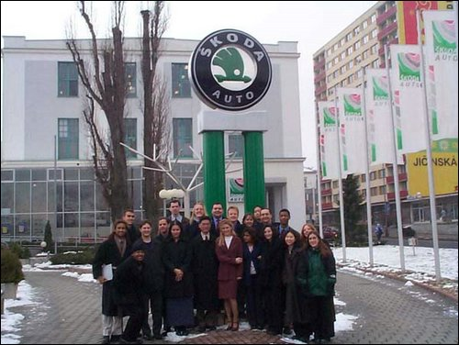
Implementation:
managing design

